Slide 1
Electric Potential
Definition of electric potential and potential difference
Electric potential and potential energy due to charges
Relation between electric field and electric potential
Electric potential due to a charged conductor
Introduction

Slide 2
Electric Potential, Introduction
We have discussed the electric forces of electromagnetism in the previous chapters.
In this chapter, electromagnetism will be linked to energy.
By using an energy approach, we can solve problems that were insoluble using forces.
Because the electrostatic force is conservative, electrostatic phenomena can be conveniently described in terms of an electric potential energy.
This will enable the definition of electric potential energy and electric potential.
Introduction

Slide 3
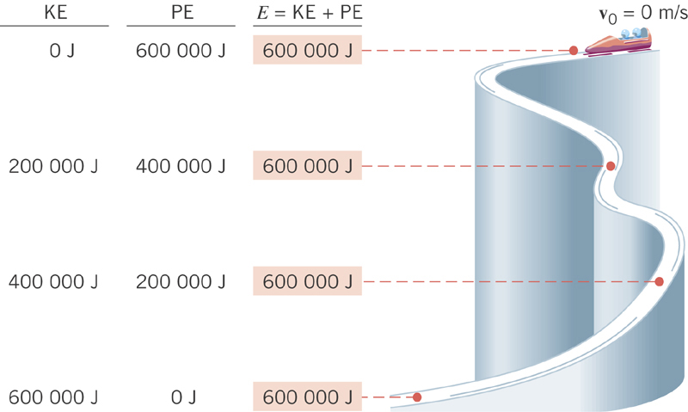
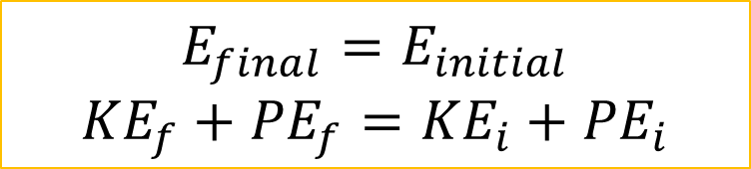
A brief review of the conservation of (mechanical) energy
Conservation of Mechanical Energy
$$E_{final}=E_{initial}$$
$${KE}_{f}+{PE}_{f}={KE}_{i}+{PE}_{i}$$
Gravitational Potential Energy transforms to
Kinetic Energy
Decrease in PE
Increase in KE

Slide 4
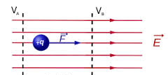
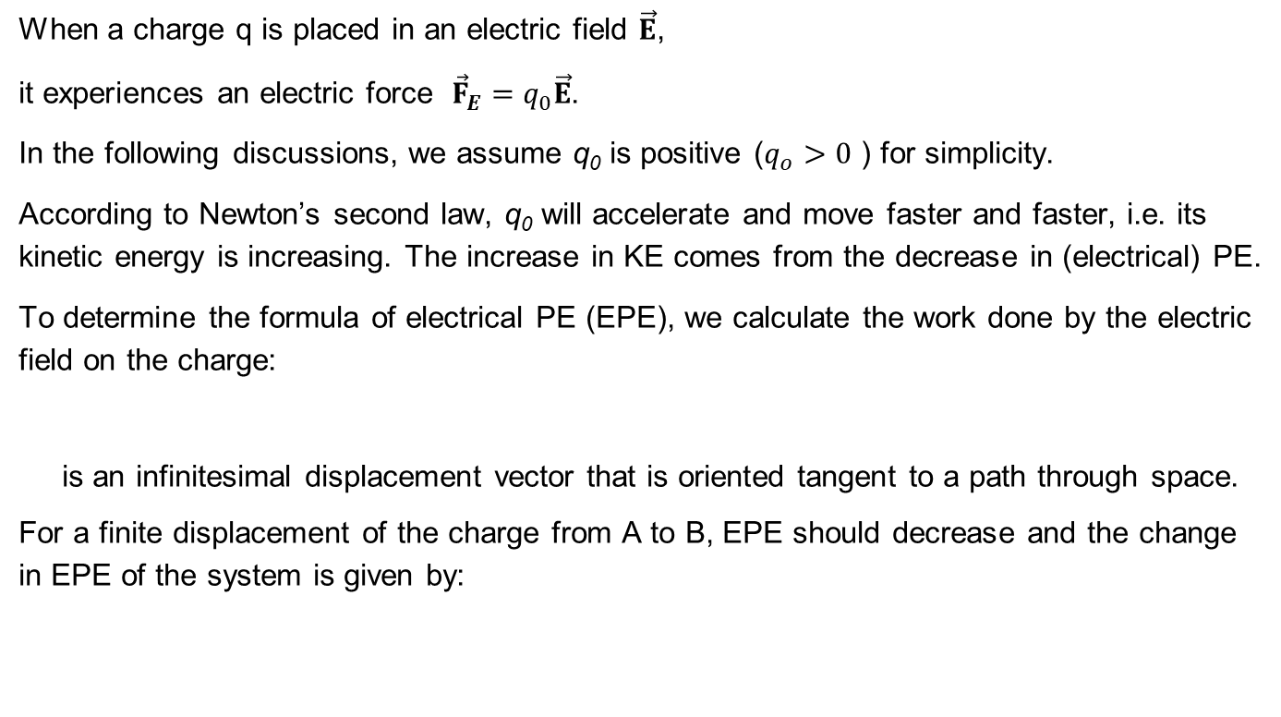
Electrical Potential Energy (EPE)
A
B
When a charge q is placed in an electric field $\vec{E}$,
it experiences an electric force ${\vec{F}}_{E}=q_{0}\vec{E}$.
In the following discussions, we assume q₀ is positive ($q_{o}>0$ ) for simplicity.
According to Newton’s second law, q₀ will accelerate and move faster and faster, i.e. its kinetic energy is increasing. The increase in KE comes from the decrease in (electrical) PE.
To determine the formula of electrical PE (EPE), we calculate the work done by the electric field on the charge:
is an infinitesimal displacement vector that is oriented tangent to a path through space.
For a finite displacement of the charge from A to B, EPE should decrease and the change in EPE of the system is given by:
The negative sign means that as a positive charge moves along the field lines, the potential energy decreases.
Note that the discussion above is also valid for $q_{o}<0$.

Slide 5
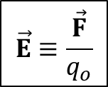
Electric Potential
Noted that the electric potential energy depends on the charge q₀.
Similar to the derivation of the electric field which is just the electric force per unit charge,
$$\vec{E}≡\frac{\vec{F}}{q_{o}}$$
we would like to define a physical quantity which is electrical potential energy per unit charge, $\frac{U}{q_{o}}$. :
Units: 1 J/C ≡ 1 V
It is called the electric potential V.
*Since V is just energy per unit charge, multiplying charge (q) and potential (V) will give you the energy (U), i.e. ΔU = qΔV.

Slide 6
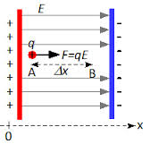
Example 1: Potential Difference in a Uniform Field
The equations for electric potential between two points A and B can be simplified if the electric field is uniform:
The displacement points from A to B is parallel to the field lines.
The negative sign indicates that the electric potential
at point B is lower than that at point A.
A positive charge moving along the electric field lines will decrease its electrical potential energy and increase its kinetic energy.
Electric field lines always point in the direction
of decreasing electric potential.
V=3
V=2
V=1

Slide 7
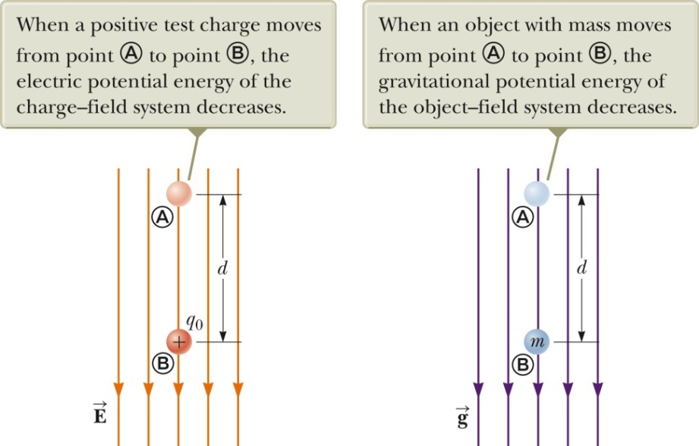
Energy and the Direction of Electric Field
An electric field does work on a positive charge when the charge moves in the direction of the electric field.
Conservation of Energy:
The charged particle gains kinetic energy and the potential energy of the charge-field system decreases by an equal amount of energy.
If q_{o} is negative, then ΔU is positive. In other word, a system consisting of a negative charge and an electric field gains potential energy when the charge moves in the direction of the field. In order for a negative charge to move in the direction of the field, an external agent must do positive work on the charge.

Slide 8
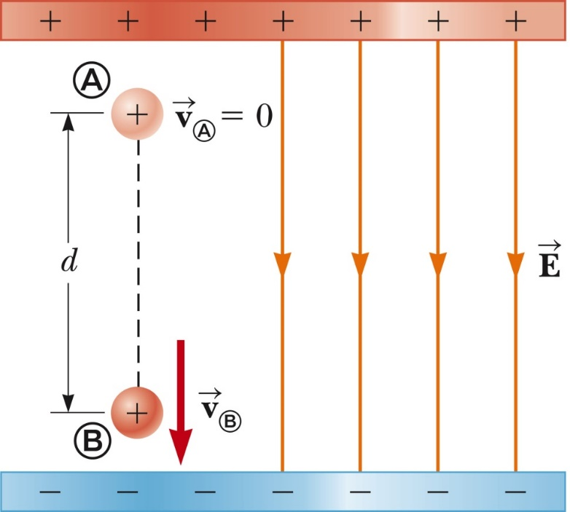
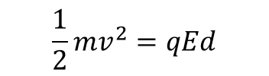
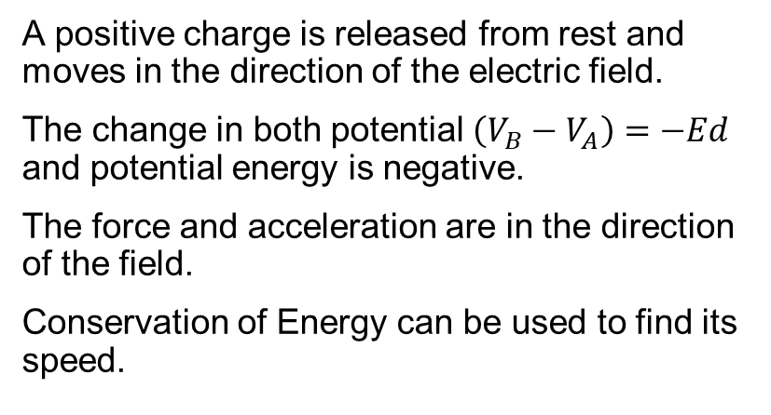
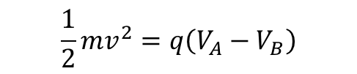


Charged Particle in a Uniform Field, Example
A positive charge is released from rest and moves in the direction of the electric field.
The change in both potential $\left(V_{B}−V_{A}\right)=−Ed$ and potential energy is negative.
The force and acceleration are in the direction of the field.
Conservation of Energy can be used to find its speed.
${KE}_{B}+{PE}_{B}$ = ${KE}_{A}+{PE}_{A}$
$$\frac{1}{2}mv^{2}+qV_{B}=0+qV_{A}$$
$$\frac{1}{2}mv^{2}=q\left(V_{A}−V_{B}\right)$$
$$\frac{1}{2}mv^{2}=qEd$$

Slide 9
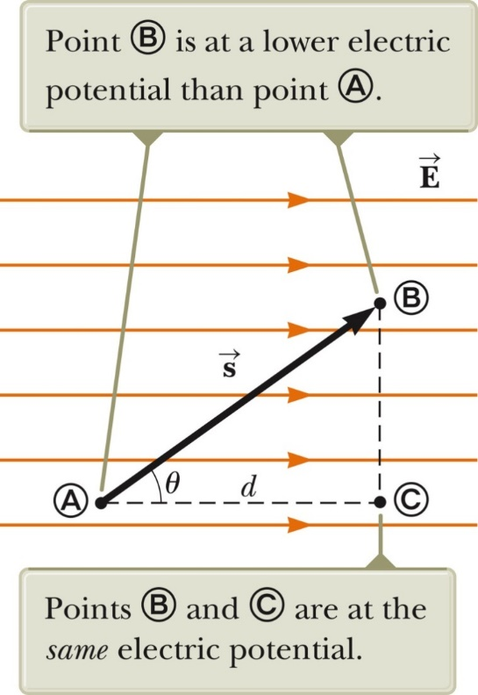
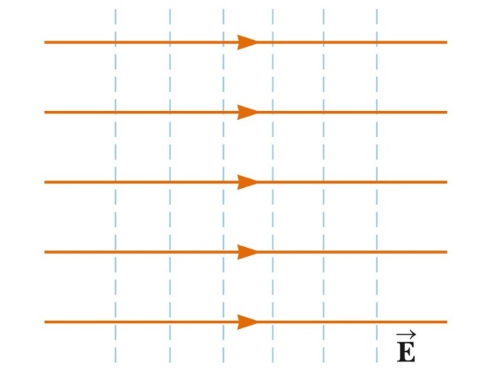
Equipotentials
Consider the work done along AB & AC.
Both work done are the same.
Therefore, points B and C are at the same potential.
In fact, all points ( ) in a plane perpendicular to a uniform electric field are at the same electric potential.
The name equipotential surface is given to any surface consisting of a continuous distribution of points having the same electric potential.
Equipotential surfaces are perpendicular to electric field lines

Slide 10
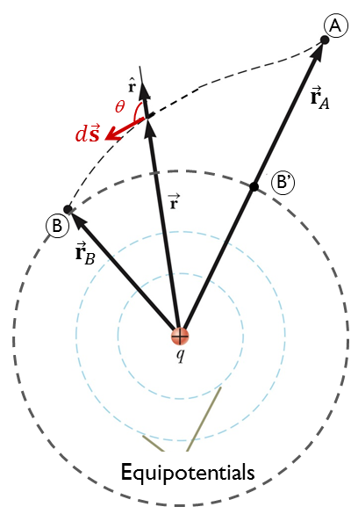
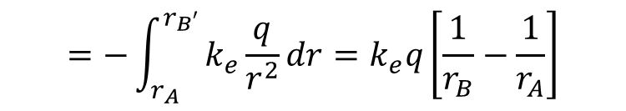
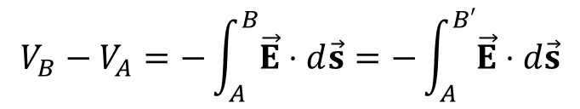
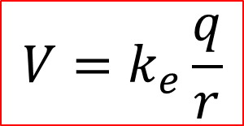
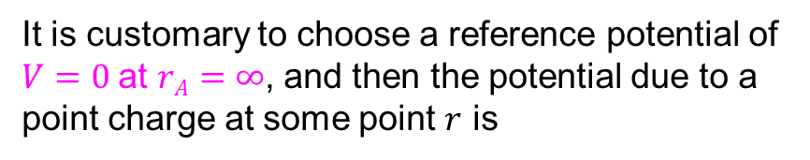
Electric Potential of a Point Charge
An isolated positive point charge (q) produces a field directed radially outward.
The potential difference between points A and B will be
$$V_{B}−V_{A}=−\int_{A}^{B}{\vec{E}⋅d\vec{s}}=−\int_{A}^{B′}{\vec{E}⋅d\vec{s}}$$
$$=−\int_{r_{A}}^{r_{B′}}{k_{e}\frac{q}{r^{2}}dr}=k_{e}q\left[\frac{1}{r_{B}}−\frac{1}{r_{A}}\right]$$
It is customary to choose a reference potential of $V=0$at $rA=∞$, and then the potential due to a point charge at some point $r$ is
$$V=k_{e}\frac{q}{r}$$

Slide 11
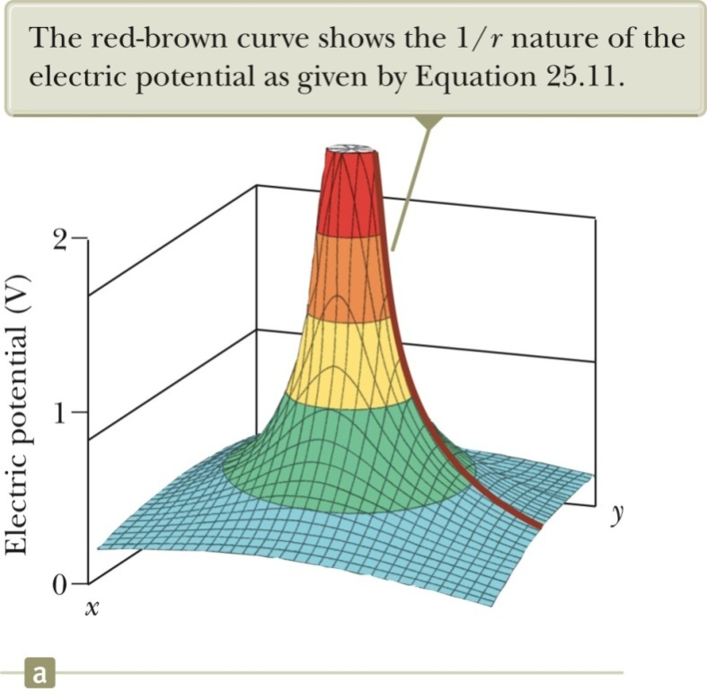
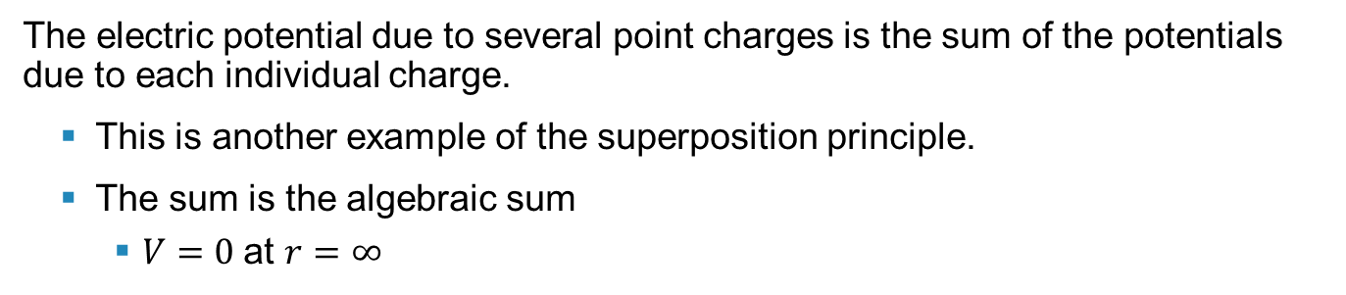
Electric Potential of a Point Charge
The electric potential in the plane around a single point charge is shown.
The red-brown line shows the 1/r nature of the potential.
Electric Potential with Multiple Charges
The electric potential due to several point charges is the sum of the potentials due to each individual charge.
This is another example of the superposition principle.
The sum is the algebraic sum
$V=0$at $r=∞$

Slide 12
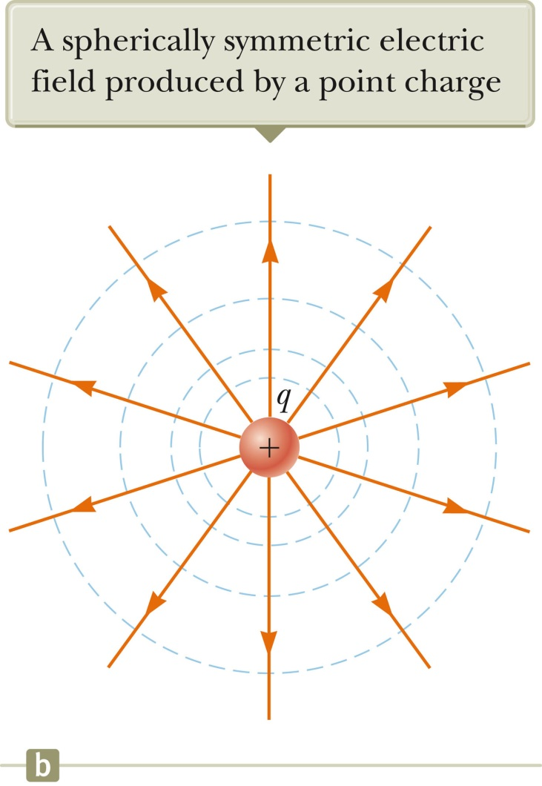
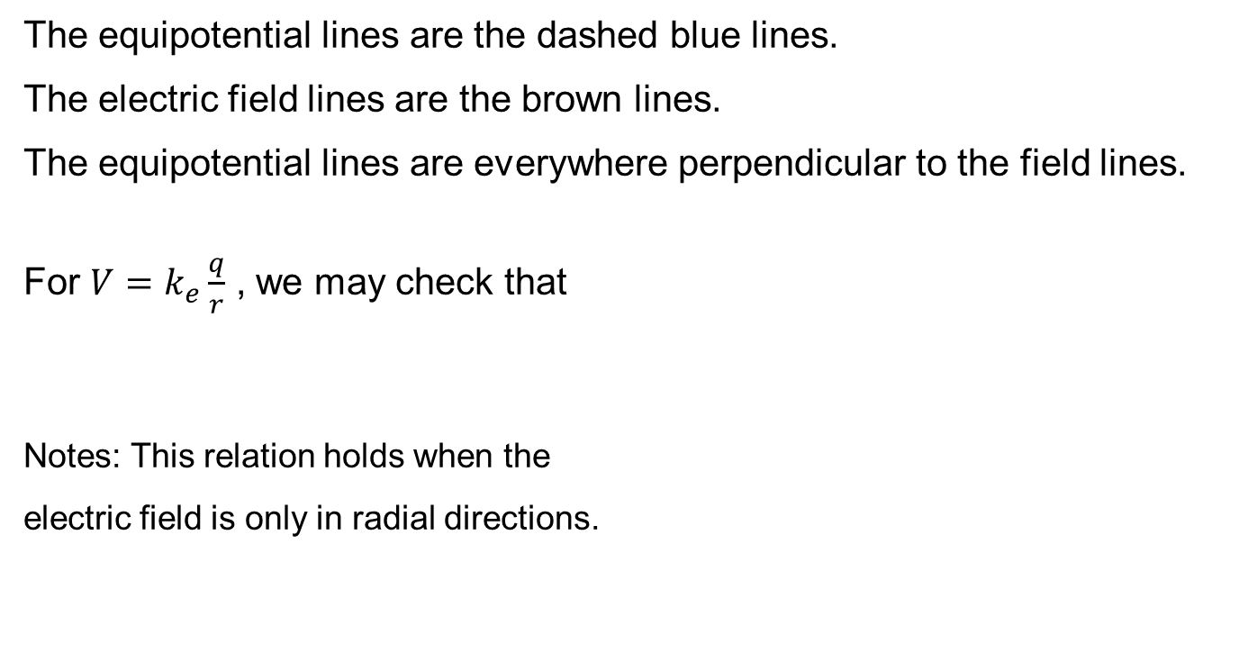
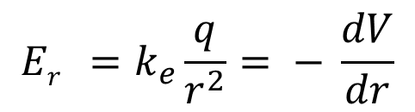
E and V for a Point Charge
The equipotential lines are the dashed blue lines.
The electric field lines are the brown lines.
The equipotential lines are everywhere perpendicular to the field lines.
For $V=k_{e}\frac{q}{r}$ , we may check that
Notes: This relation holds when the
electric field is only in radial directions.
$$Er =k_{e}\frac{q}{r^{2}}= − \frac{dV}{dr}$$

Slide 13
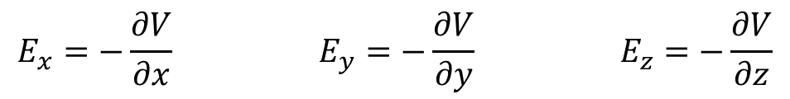
Finding E From V
If the electric field has only an x component, we have
Similar statements would apply to the y and z components.
Equipotential surfaces must always be perpendicular to the electric field lines passing through them.
Electric Field from Potential, General
In general, the electric potential is a function of all three dimensions. Given V (x, y, z) you can find the electric field components E_{x}, E_{y} and E_{z} by doing partial differentiations:
$$E_{x}=−\frac{∂V}{∂x} E_{y}=−\frac{∂V}{∂y} E_{z}=−\frac{∂V}{∂z}$$
(treat y, z as constants)
(treat x, z as constants)
(treat x, y as constants)
The symbol “$∂$” has a meaning similar to “$d$” in calculus. It is used when more variables is used.

Slide 14
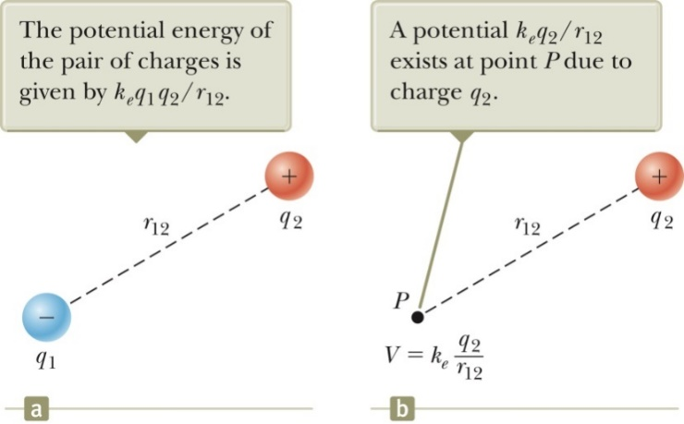
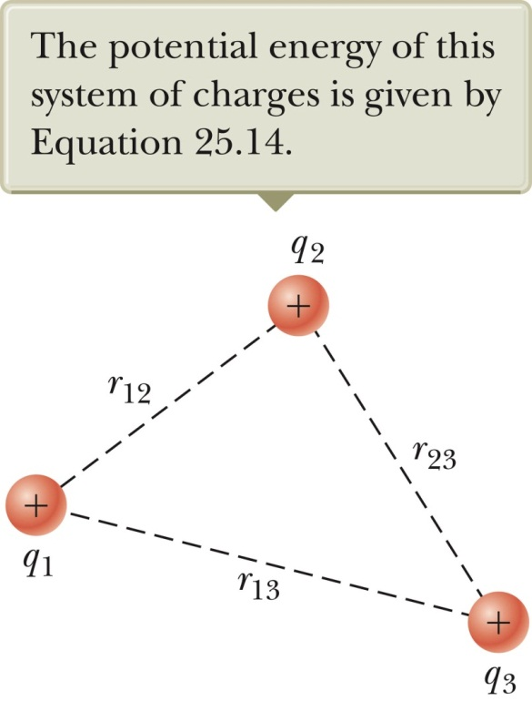
Potential Energy of Multiple Charges
The potential energy of the system is
If the two charges are the same sign, U is positive and work must be done to bring the charges together.
If the two charges have opposite signs, U is negative and negative work is done to bring the charges together. Energy is needed to keep the charges apart.
If there are more than two charges, then find U for each pair of charges and add them.
For three charges:

Slide 15
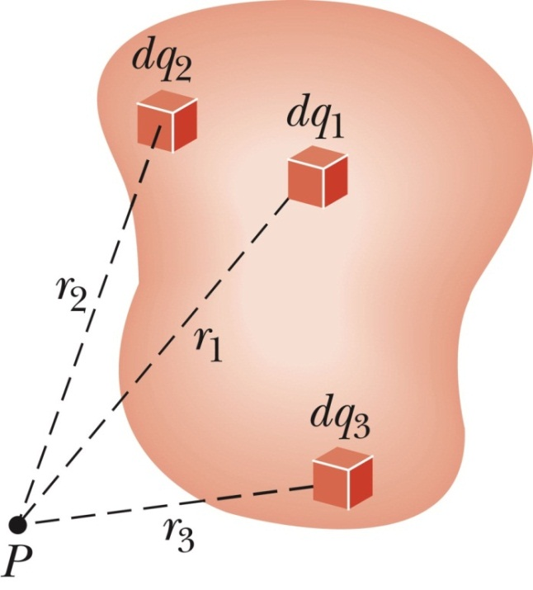
Example 3: Electric Potential for a Continuous Charge Distribution
Method 1: The charge distribution is known. Consider a small charge element dq
Treat it as a point charge.
The potential at some point due to this charge element is
To find the total potential, you need to integrate to include the contributions from all the elements.
Method 2: If the electric field is already known from other considerations, the potential can be calculated using the original approach:
If the charge distribution has sufficient symmetry, first find the field from Gauss’s Law and then find the potential difference between any two points.

Slide 16
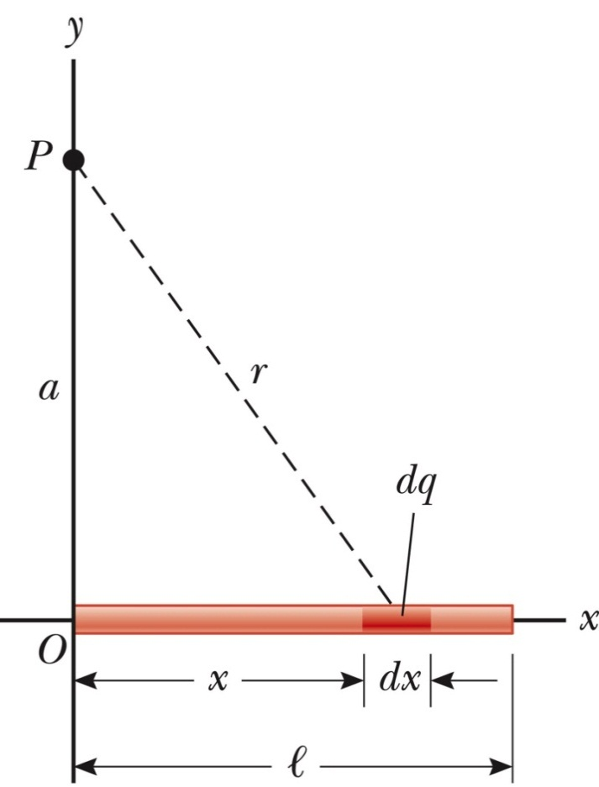
V for a Finite Line of Charge (Optional)
A rod of line ℓ has a total charge of Q and a linear charge density of λ.
There is no symmetry to use, but the geometry is simple.

Slide 17
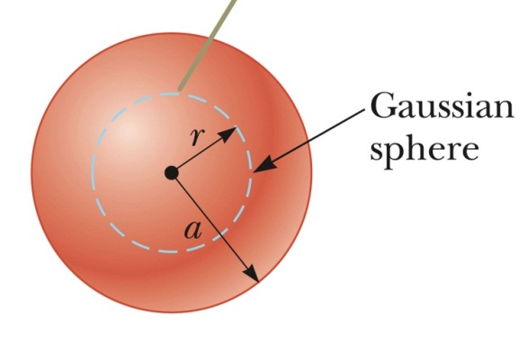
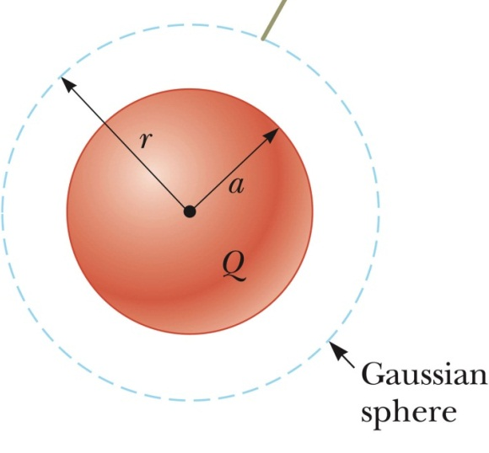
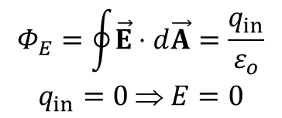
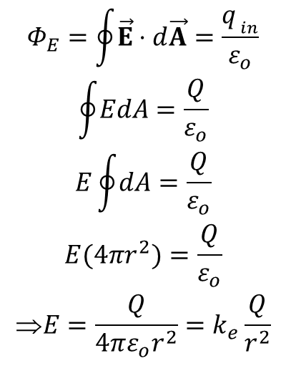
Example: Calculate E first, then V
(a) For a conducting sphere with radius R and net charge Q, determine the E-field at the center of the sphere and right outside its surface.
At the center:
The charges reside on the surface of the conducting sphere
$$\begin{aligned}Φ_{E}=\oint{\vec{E}⋅d\vec{A}}=\frac{q_{in}}{ε_{o}} \\ q_{in}=0 ⇒ E=0\end{aligned}$$
Right outside its surface
$$\begin{matrix}\begin{aligned}Φ_{E}=\oint{\vec{E}⋅d\vec{A}}=\frac{q_{ _{in}}}{ε_{o}} \\ \oint{EdA}=\frac{Q}{ε_{o}} \\ E\oint{dA}=\frac{Q}{ε_{o}} \\ E(4πr^{2})=\frac{Q}{ε_{o}}\end{aligned} \\ E=\frac{Q}{4πε_{o}r^{2}}=k_{e}\frac{Q}{r^{2}}\end{matrix}$$

Slide 18
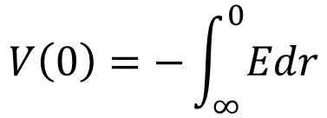
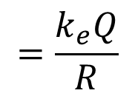
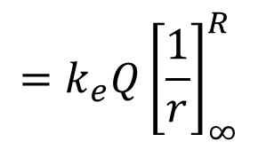
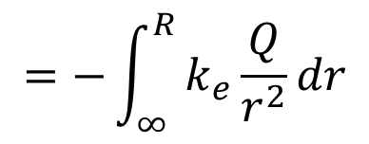
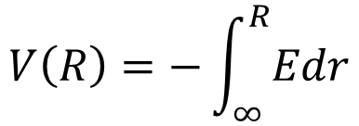
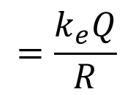
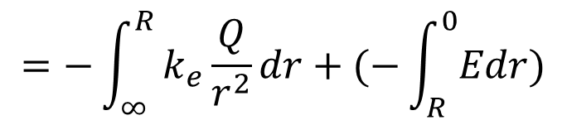
Example: Calculate E first, then V
(b) Derive the electric potential V at the surface and at the center of the sphere, assuming V=0 at infinite distance.
At the surface
At the center:
$$V\left(R\right)=−\int_{∞}^{R}{Edr}$$
$$V\left(0\right)=−\int_{∞}^{0}{Edr}$$
$$=−\int_{∞}^{R}{k_{e}\frac{Q}{r^{2}}dr}$$
$$=−\int_{∞}^{R}{k_{e}\frac{Q}{r^{2}}dr}+(−\int_{R}^{0}{Edr})$$
$$=k_{e}Q{\left[\frac{1}{r}\right]}_{∞}^{R}$$
$$=\frac{k_{e}Q}{R}$$
$$=\frac{k_{e}Q}{R}$$

Slide 19
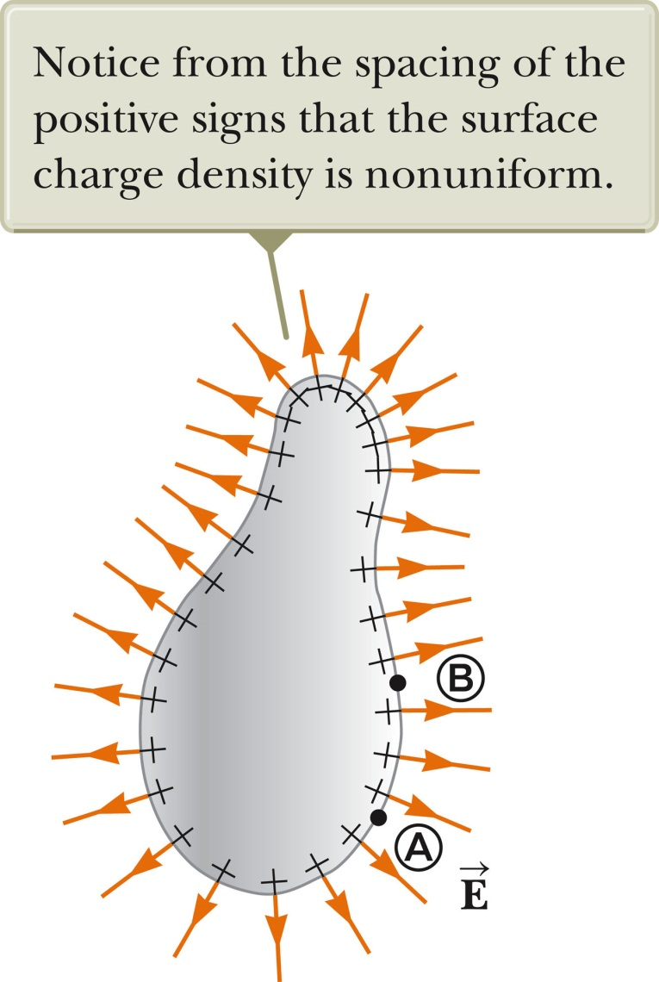
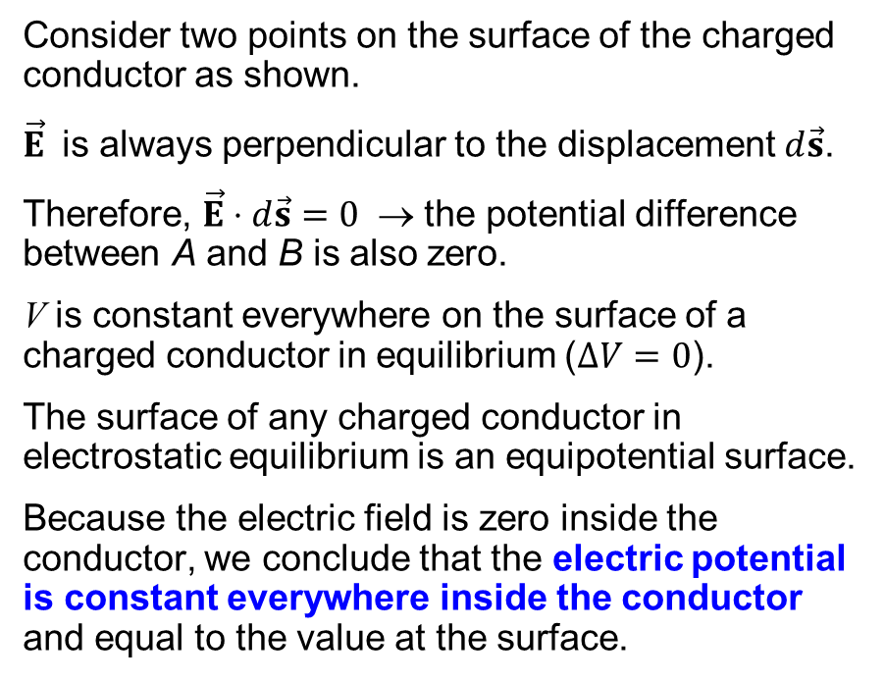
Example: electric potential due to a charged conductor
Consider two points on the surface of the charged conductor as shown.
$\vec{E}$ is always perpendicular to the displacement $d\vec{s}$.
Therefore, $\vec{E}⋅d\vec{s}=0$ → the potential difference between A and B is also zero.
V is constant everywhere on the surface of a charged conductor in equilibrium ($ΔV=0$).
The surface of any charged conductor in electrostatic equilibrium is an equipotential surface.
Because the electric field is zero inside the conductor, we conclude that the electric potential is constant everywhere inside the conductor and equal to the value at the surface.

Slide 20
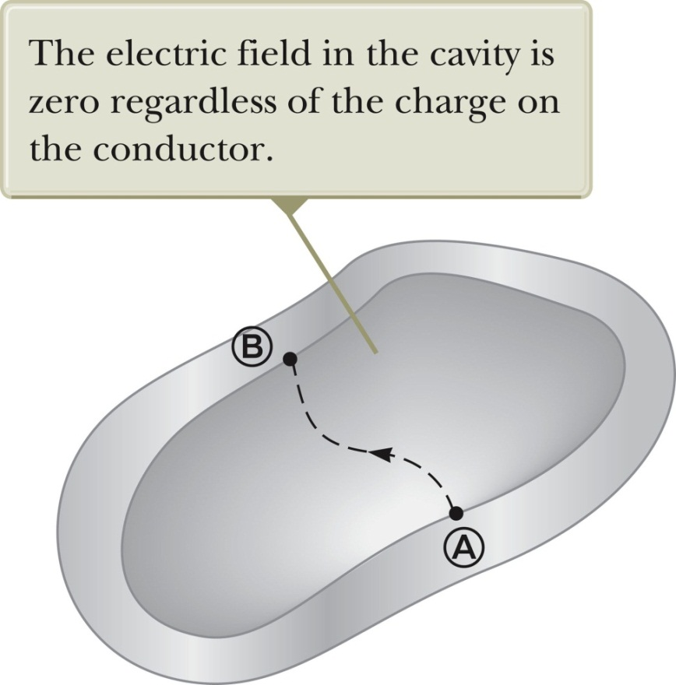
Cavity in a Conductor
Assume an irregularly shaped cavity is inside a conductor.
Assume no charges are inside the cavity.
The electric field inside the conductor must be zero.
The electric field inside does not depend on the charge distribution on the outside surface of the conductor.
For all paths between A and B,
A cavity surrounded by conducting walls is a field-free region (E = 0) as long as no charges are inside the cavity.
Article: Electric field and potential at the surface of a conductor

Slide 21
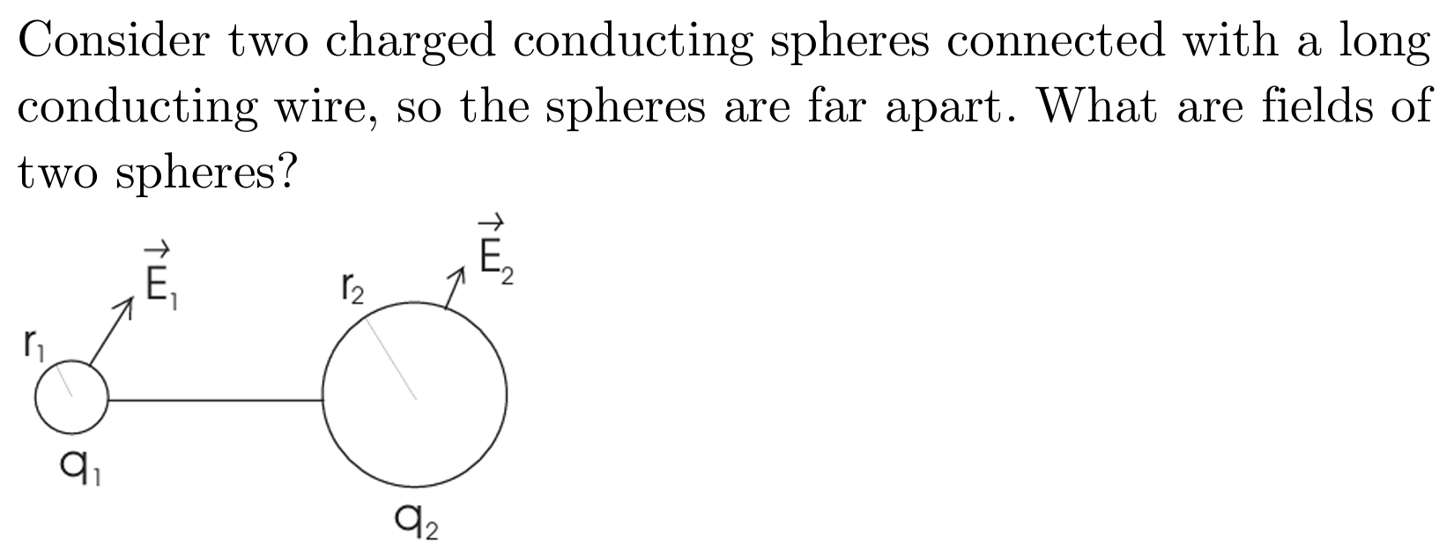

Slide 22
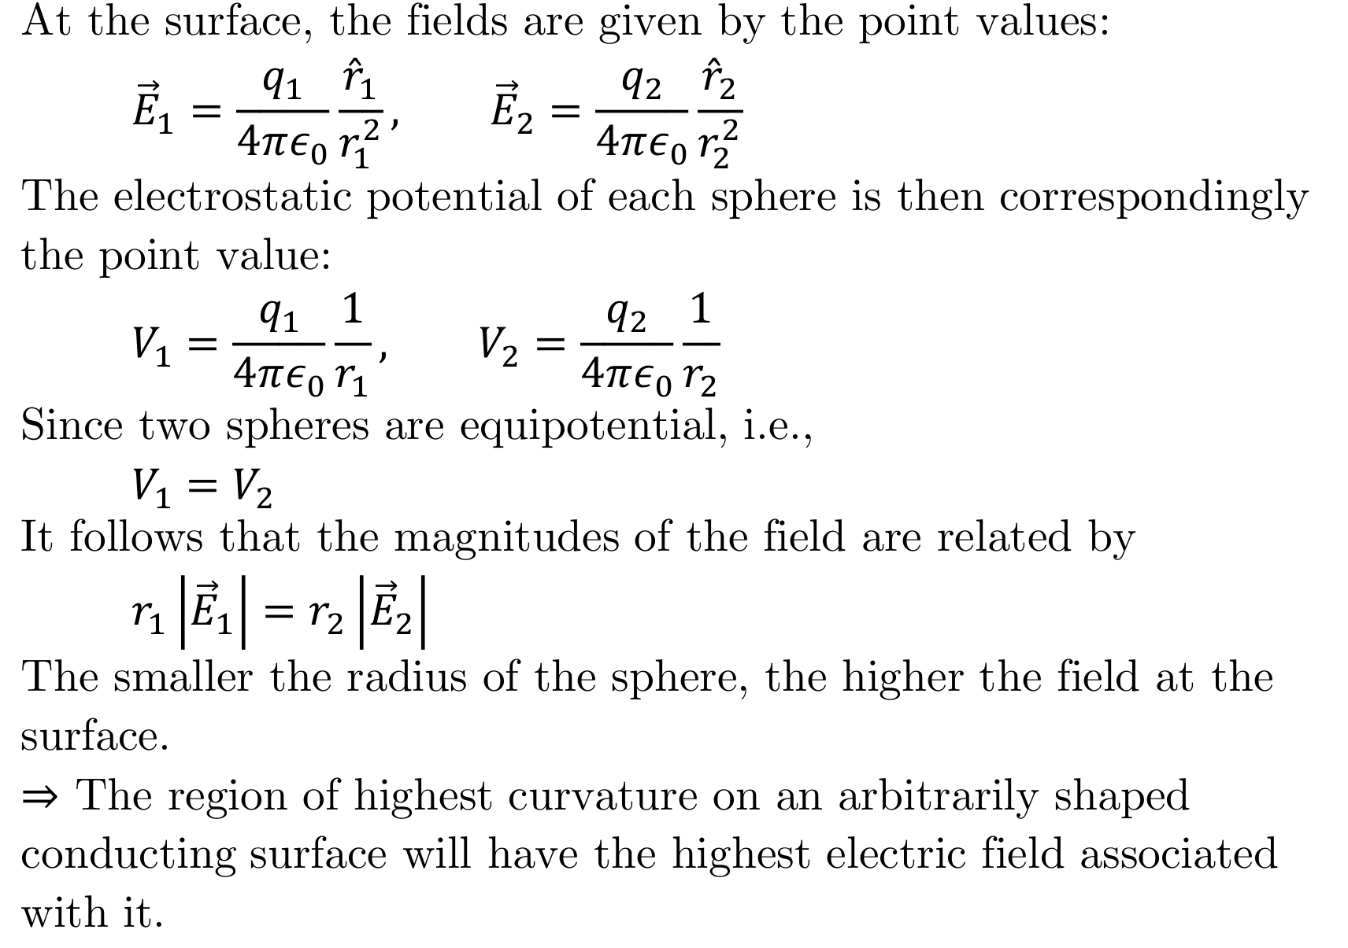

Slide 23
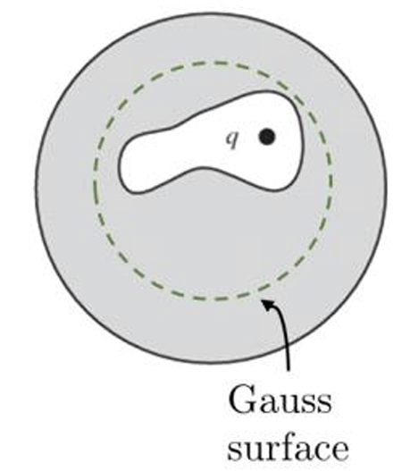

Slide 24
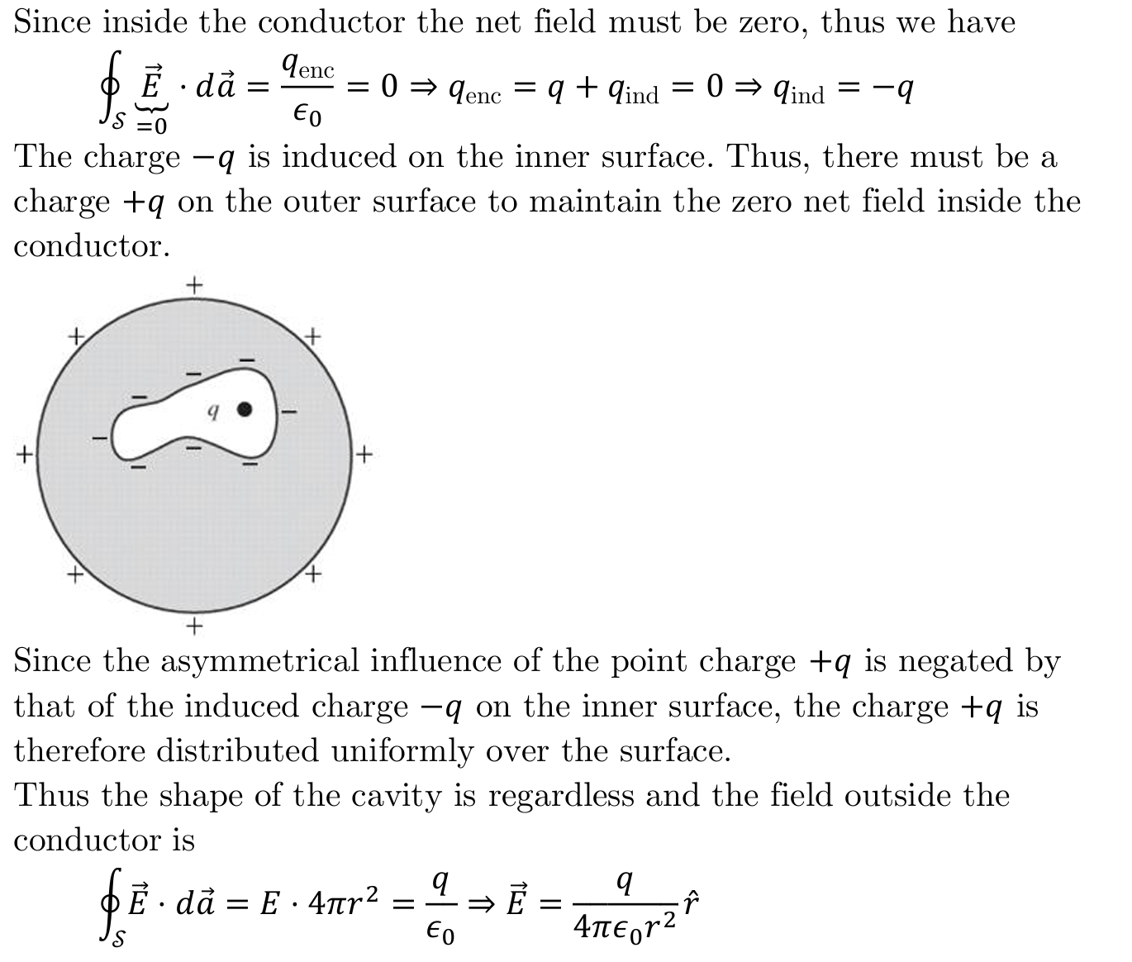

Slide 25
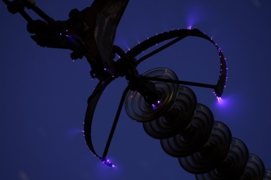
Corona Discharge (Optional)
If the electric field near a conductor is sufficiently strong, electrons resulting from random ionizations of air molecules near the conductor accelerate away from their parent molecules.
These electrons can ionize additional molecules near the conductor. This creates more free electrons with higher energy. When the energy is released as light, a glow occurs.
The corona discharge is the glow that results from the recombination of these free electrons with the ionized air molecules.
The ionization and corona discharge are most likely to occur near very sharp points.

